Slide 1

Housing Analysis
AMS 572 Project Group 2
Bohong Huang, Jing Hao, Joanna Wong, Nick Handelman, Yiming Wan.

Slide 2
Why was the “Housing Prices” Data Chosen?
Finding a house is a common task faced.
To find a house, research has to be done.
Purchasing or selling a house requires data to determine the home value.
There are many characteristics in a house.
Example: Number of Bedrooms, Age of House, Lot Size
A relationship between home characteristics or relationship between home value to a home characteristic can be tested

Slide 3
About the Data Set
Initial Purpose of the Data: To determine the home values based on the home characteristics collected in Saratoga, New York. Create a model that would determine if the house is expensive.
The random sample involves 1057 samples of houses.
Each sample will have: Price, Living Area, Number of Bathrooms
Number of Bedrooms, Number of Fireplaces,
Lot Size, House Age, Is there a fireplace?

Slide 4
Changes Made to the Data Set
Removed a column that consists of binary data whether there was a fireplace or not.
Removed the samples that contained a “NA” or “0” for the lot size.

Slide 5

Hypothesis 1: Independent Samples T- Test
Question of Interest: Is the mean price of the newest house samples the same as the mean price of the oldest house samples?
- How did we determine which samples were considered newest and oldest?
Median of the random samples: 18 years old
- Divided samples into two group with almost same size:
Group 1: The houses that are newer than or equal to 18 years (564 samples)
Group 2 : The houses that are older than 18 years (480 samples)
-Hypotheses: H₀ : vs. H_{a}:
-Significant Level: = 0.05

Slide 6
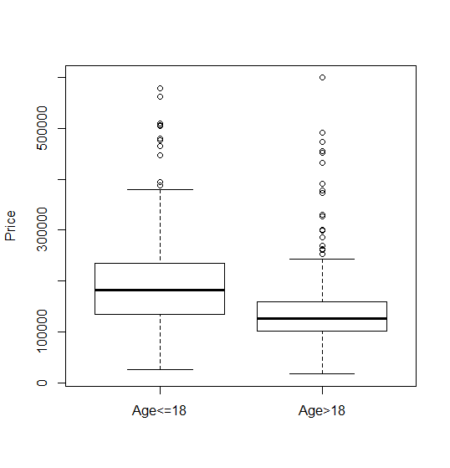
Hypothesis 1: Independent Sample T-Test
The box plots indicate that the median house less than or equal to 18 years is more expensive than the median house older than 18 years. It is difficult to make a statement about the mean house in each group.

Slide 7
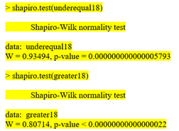
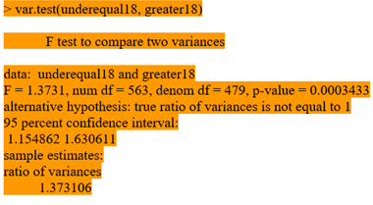
Hypothesis 1: Validity of Assumptions R Outputs
Shapiro-Wilk tests was performed on each group. - Equal Variances F-Test for two groups

Slide 8
Hypothesis 1: Validity of Assumptions
Independent sample: The data is a random sample, and each of them are independent to each other.
Normality: The sample size is large, so the means of both groups follow a normal distribution with the Central Limit Theorem.
Equal variance assumption: We use un-pooled t-test here since our data is violated to this assumption.

Slide 9

Hypothesis 1: Results
Assumed unequal variances, Welch Independent Samples T-test was used.
P-Value: <0 .00000000000000022
95% Confidence Interval : (46034.43, 63352.19)
Conclusion: We can reject H₀ at = 0.05 . There is evidence that the mean price of the newest houses which are 18 years or younger are greater than the mean price of the oldest houses which are older than 18 years.

Slide 10
Hypothesis 2: Analysis with One-Way ANOVA
Question of interest: For the houses with different number of fireplaces, is the mean age equal?
Divided samples into 5 groups with different number of fireplaces.
Considering the group counts, the ANOVA test will have 3 groups:
Houses with 0 fireplaces,
Houses with 1 fireplace
Houses with 2 or more fireplaces.
Fireplaces | 0 | 1 | 2 | 3 | 4
House count | 422 | 595 | 24 | 2 | 1

Slide 11
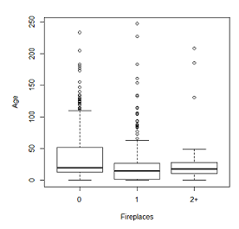
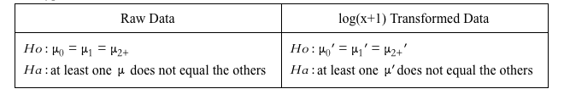
Hypothesis 2: Analysis with One-Way ANOVA
-Hypotheses
- Significance Level: ɑ =0.05
For the raw data it is difficult to make an initial statement about the equality of the group population means based on the data. Within each group, the samples are clearly not normally distributed. The data does indicate that, due to the right skewness the population means are likely greater than the population medians.

Slide 12
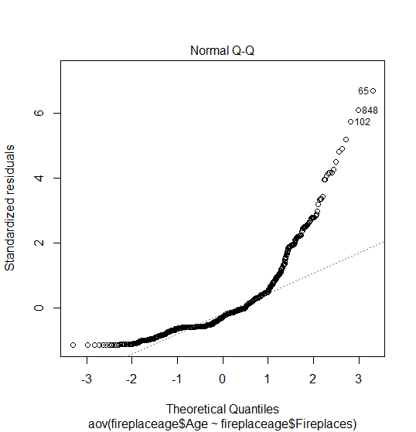
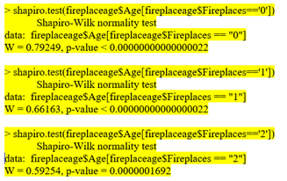
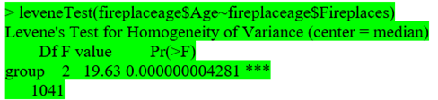
Hypothesis 2: One-Way ANOVA on the Raw Data
Shapiro-Wilk Test: Groups are not all normally distributed
Levene’s Test: Groups do not have same variance
Normal Plot: Residuals are not normally distributed

Slide 13

Hypothesis 2: One-Way ANOVA on Raw Data
F-statistic = 37.23 for 2 and 1041 degrees of freedom.
Conclusion: We reject H₀ , but assumptions not met ,so the result is questionable. It is possible that a transformation of the data can be applied, and the resulting transformed data will meet the assumptions.

Slide 14
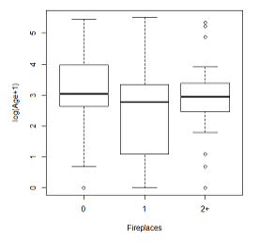

Hypothesis 2: Analysis about log(x+1) data
-Hypothesis
-Significant level: =0.05
log(x+1) transformed data
The transformed samples indicate that the transformed populations are more normally distributed within each group. This indicates that the transformed means are closer to the transformed medians. Therefore, it is easier to make an initial statement that the transformed group means are equal.

Slide 15
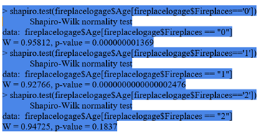
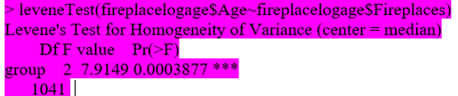
Hypothesis 2: One-Way ANOVA on Log(x+1) Data
Group 2+: Does not have enough evidence to reject that population is normally distributed.
Groups 0 and 1: Can reject that group population is normally distributed
Levene’s Test: Groups do not have same variance

Slide 16
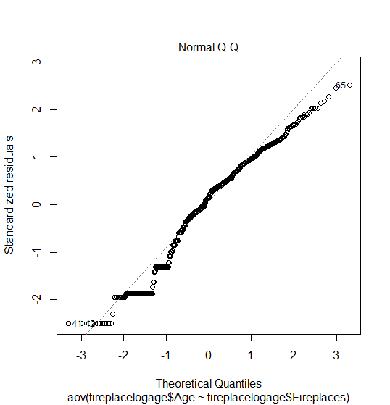

Hypothesis 2: One-Way ANOVA on Log(x+1) Data
Shapiro-Wilk test shows that the residuals follow non-normality
Normal Plot shows residuals are more normally distributed than the raw data.

Slide 17

Hypothesis 2: One-Way ANOVA on Log(x+1) Data
F statistic = 50.05 on 2 and 1041 degrees of freedom
Conclusion: We reject H₀. At least one of the means for log transformed data is not equal to another. Also, the assumptions not met so the result is still questionable, but may be more valid than the raw data results.

Slide 18
Hypothesis 3: Multiple Linear Regression
BTS album2ne
Question of Interest: Is there a linear relation between living area and other house characteristics including number of bathrooms(x₁), number of bedrooms(x₂), number of fireplaces(x₃), lot size(x₄) and age(x₅)?
Model : Multiple Linear regression between the living area and the other house characteristics listed above.

Slide 19
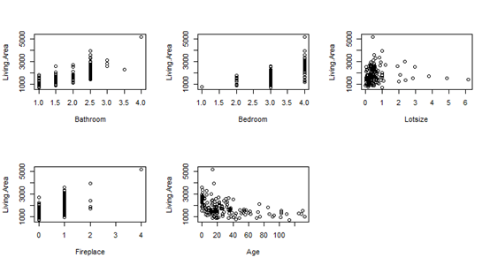
Hypothesis 3: Multiple Linear Regression
From the above plots, it appears that living area has a positive linear relationship with bathrooms and fireplaces and possibly bedrooms. Living area appears to have a slight negative curvilinear relationship with age, but this may just be due to the visual influence of certain outliers. For lot size, most observations appear to be in one cluster, and the remaining observations give a slight curvilinear appearance.

Slide 20
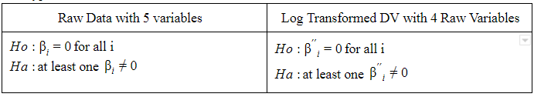
Hypothesis 3: Multiple Linear Regression
Initially, all 5 variables are considered, and the results indicate that age is not a significant contributing factor and that a transformation may help meet certain assumptions. For the second model, the other 4 variables are considered and a log transform is applied to the dependent variable (living area) in an attempt to develop a model that meets the required assumptions.

Slide 21
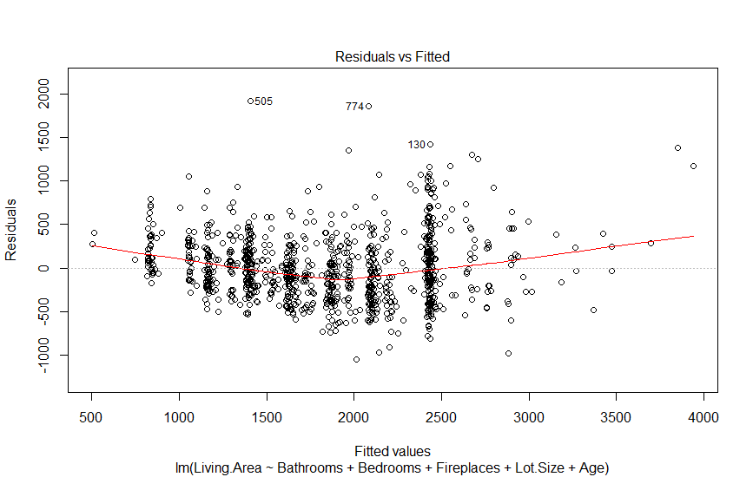
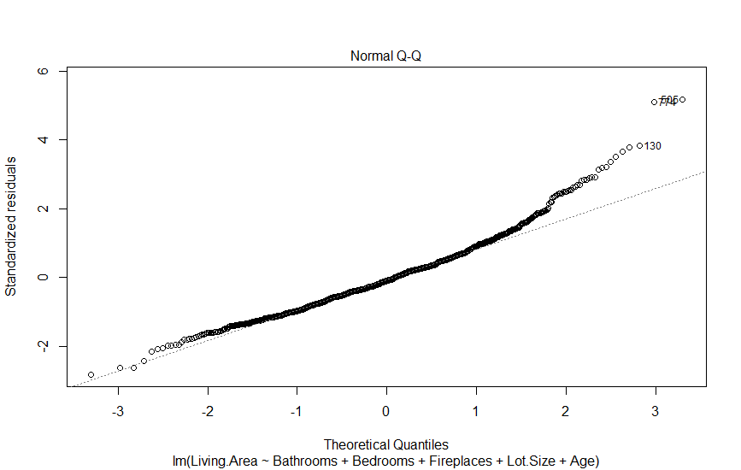
Hypothesis 3: One Raw Dependent Variable and Five Raw Independent Variables
The scatter plot of fitted values vs. residuals above shows a slight curvilinear relationship, indicating that a linear model may not be the best fit for this hypothesis.
The normal plot indicates that the residuals are not normally distributed.
Notes:
The first plot also shows that the equal variances assumption at all values of the independent variable is violated, with the variance greater in the center. So, a transformation and/or introduction of a quadratic independent variable may help.

Slide 22
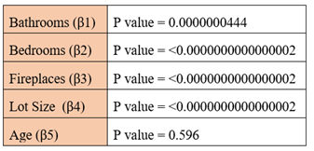
Hypothesis 3: One Raw Dependent Variable and Five Raw Independent Variables
Model: Y = -306.2138 + 465.6220x₁ + 324.9219x₂ + 240.8739x₃ + 65.3176x₄ + 0.1962x₅
Adjusted R² = 0.6861
Conclusion:
There is not enough evidence that β₅ (age) is not equal to 0. It will be removed in the revised model.
The other variables have p-value < 0.05, so there is sufficient evidence that the associated coefficients are not 0. Therefore, will be kept in the revised model.

Slide 23
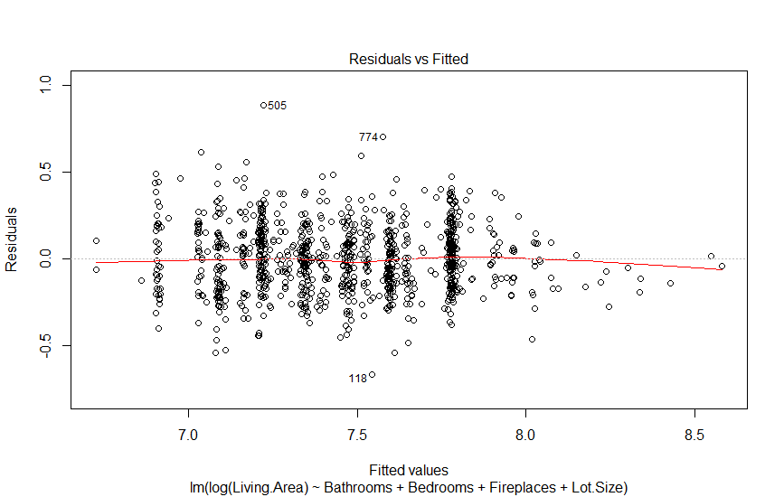
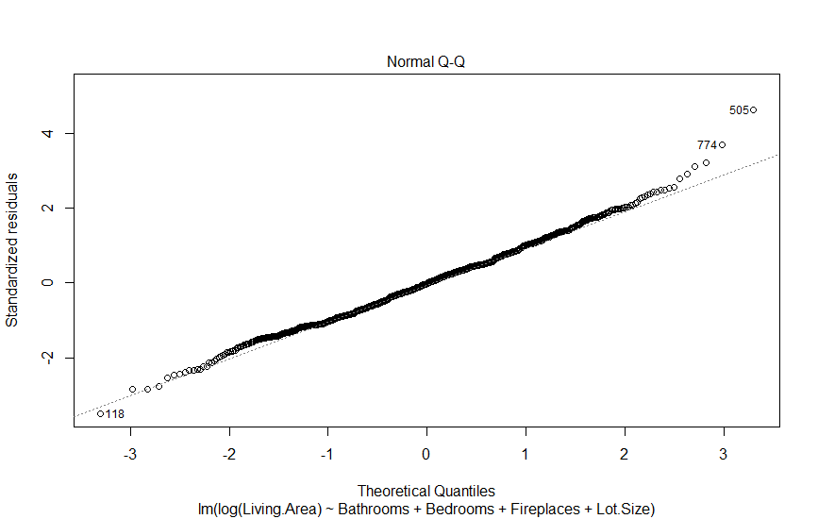
Hypothesis 3: One Log Transformed Dependent Variable and Four Raw Independent Variables
In the revised model, the living area is log transformed and the age variable is removed.
The scatter plot shows a linear relationship, indicating that the relationship between the independent and dependent variables is linear. The plot also shows an improvement in the equal variances assumption at all values of the independent variable.
Notes:
In the revised model, the living area is log transformed and the age variable is removed. The results of the multiple regression are provided in Appendix 7 (light blue highlighted). All of the variables have p-values < 0.05, indicating that there is sufficient evidence to indicate that their associated coefficients are not 0. Also, the adjusted R² increased from 0.6861 to 0.7066, indicating that this revised model better explains the variation in living area than the original model,without overfitting. The normal plot isn’t clear about the normality of the residuals, but it does show an improvement in normality over the original model. It appears to still be slightly non-normal due to the tails, and a Shapiro-Wilk test indicates that residuals are not normally distributed. The VIF values are again all less than 3, so the multicollinearity assumption is not violated.

Slide 24
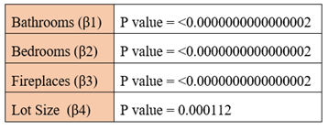
Hypothesis 3: One Log Transformed Dependent Variable and Four Raw Independent Variables
Model: Y = 6.294285 + 0.247524x₁ + 0.179398x₂ + 0.133410x₃ + 0.030316x₄
Adjusted R² = 0.7066
Conclusion:
All the variables have p values < 0.05. There is sufficient evidence that shows that the associated coefficients are not 0.
The adjusted R² increased from 0.6861 to 0.7066 which shows that the revised model explains the living area variation better without overfitting

Slide 25

Hypothesis 3: One Log Transformed Dependent Variable and Four Raw Independent Variables
Adding 1 to any variable, while holding the other variables constant, increases living area by 100*(e^{βi}-1)%.

Slide 26
Conclusion
Hypothesis 1: Reject the null hypothesis, H₀, at = 0.05. There is evidence that the mean price for houses that are less than or equal to 18 years of age is greater than the mean price for the houses that are older than 18 years.
Hypothesis 2 : Reject the null hypothesis, H₀, at = 0.05. The mean age for houses with 0, 1 or 2+ fireplaces are not all equal. Since assumptions are not met for raw and log transformed data, results are in question.
Hypothesis 3: All the coefficients, β_{i},have p-values < 0.05. There is sufficient evidence that shows that the coefficients are not 0. The adjusted R² increased from 0.6861 to 0.7066 which shows that the revised model explains the living area variation better without overfitting than the original model.

Slide 27
Appendix: R Code for Hypothesis 1
options(scipen=999)
priceage = read.table("C:\\Users\\Nick\\Desktop\\AMS\\572\\Project\\AMS 572 Housing Data.csv", header=TRUE, sep=",", colClasses=c(NA,"NULL","NULL","NULL","NULL","NULL",NA))
median(priceage$Age)
underequal18 = subset(priceage, Age<=18)[,1]
greater18 = subset(priceage, Age>18)[,1]
length(underequal18)
length(greater18)
boxplot(underequal18,greater18, names=c("Age<=18","Age>18"), ylab="Price")
shapiro.test(underequal18)
shapiro.test(greater18)
var.test(underequal18, greater18)
t.test(underequal18, greater18)
plot(priceage[,2],priceage[,1],xlim=c(0, 250), ylim=c(0, 600000),xlab="Age",ylab="Price")

Slide 28
Appendix: R Code for Hypothesis 2
shapiro.test(fireplaceage$Age[fireplaceage$Fireplaces=='0'])
shapiro.test(fireplaceage$Age[fireplaceage$Fireplaces=='1'])
shapiro.test(fireplaceage$Age[fireplaceage$Fireplaces=='2'])
leveneTest(fireplaceage$Age~fireplaceage$Fireplaces)
fit = aov(fireplaceage$Age~fireplaceage$Fireplaces)
summary(fit)
plot(fit)
shapiro.test(fit$residuals)
#log(x+1) transformed data analysis
fireplacelogage = fireplaceage
fireplacelogage$Age = log(fireplacelogage$Age+1)
boxplot(fireplacelogage$Age~fireplacelogage$Fireplaces, names=c("0","1","2+"), ylab="log(Age+1)", xlab="Fireplaces")
shapiro.test(fireplacelogage$Age[fireplacelogage$Fireplaces=='0'])
shapiro.test(fireplacelogage$Age[fireplacelogage$Fireplaces=='1'])
shapiro.test(fireplacelogage$Age[fireplacelogage$Fireplaces=='2'])
leveneTest(fireplacelogage$Age~fireplacelogage$Fireplaces)
fit = aov(fireplacelogage$Age~fireplacelogage$Fireplaces)
summary(fit)
plot(fit)
shapiro.test(fit$residuals)
library(car)
options(scipen=999)
fireplaceage = read.table("C:\\Users\\nhand\\Desktop\\AMS572Project\\AMS 572 Housing Data.csv",
header=TRUE, sep=",", colClasses=c("NULL","NULL","NULL","NULL",NA,"NULL",NA))
length(fireplaceage$Fireplaces[fireplaceage$Fireplaces==0])
length(fireplaceage$Fireplaces[fireplaceage$Fireplaces==1])
length(fireplaceage$Fireplaces[fireplaceage$Fireplaces==2])
length(fireplaceage$Fireplaces[fireplaceage$Fireplaces==3])
length(fireplaceage$Fireplaces[fireplaceage$Fireplaces==4])
length(fireplaceage$Fireplaces[fireplaceage$Fireplaces>=5])
fireplaceage$Fireplaces[fireplaceage$Fireplaces==3] = 2
fireplaceage$Fireplaces[fireplaceage$Fireplaces==4] = 2
fireplaceage$Fireplaces[fireplaceage$Fireplaces==0] = '0'
fireplaceage$Fireplaces[fireplaceage$Fireplaces==1] = '1'
fireplaceage$Fireplaces[fireplaceage$Fireplaces==2] = '2'
#raw data analysis
boxplot(fireplaceage$Age~fireplaceage$Fireplaces, names=c("0","1","2+"), ylab="Age", xlab="Fireplaces")

Slide 29
Appendix: R Code for Hypothesis 3
library(car)
options(scipen=999)
housedata = read.table("C:\\Users\\nhand\\Desktop\\AMS572Project\\AMS 572 Housing Data.csv",
header=TRUE, sep=",")
plot(housedata$Bathrooms, housedata$Living.Area)
plot(housedata$Bedrooms, housedata$Living.Area)
plot(housedata$Fireplaces, housedata$Living.Area)
plot(housedata$Lot.Size, housedata$Living.Area)
plot(housedata$Age, housedata$Living.Area)
fit <- lm(Living.Area ~ Bathrooms+Bedrooms+Fireplaces+Lot.Size+Age, data=housedata)
summary(fit)
plot(fit)
shapiro.test(fit$residuals)
vif(fit)
fit <- lm(log(Living.Area) ~ Bathrooms+Bedrooms+Fireplaces+Lot.Size, data=housedata)
summary(fit)
plot(fit)
shapiro.test(fit$residuals)
vif(fit)

